Slide 1
Simulation Languages
Unit-6

Slide 2
Feedback Systems: typical applications
Feedback is used to describe a coupling between the input and output of the system. A significant factor in the performance of many systems. Example :A home heating system controlled by a thermostat (Dependency upon temp). An example of continuous system control mechanism using feedback is aircraft system. Input is a desired aircraft heading and the output is the actual heading. Gyroscope of the autopilot is able to detect the difference between the two headings.
A feedback system is a control system that adjusts its output based on differences between the actual output and the desired output. It continuously monitors performance and makes corrections to achieve stability and desired behavior.
A feedback is established by using the difference to operate control surface. The difference between the desired heading theta i and actual heading theta 0 is called the error signal 'E’.

Slide 3
Suppose the control surface angle is made directly proportional to the error signal the force changing the heading is then proportional to the error and it diminishes the aircraft approaches the correct heading. When the aircraft receipt a signal to change direction control surface angle (error signals) takes non-zero value. The aircraft heading responds to the control surface by moving toward the new heading but, because of inertia it takes time to respond.

Slide 4
As the aircraft turns, the control surface angle decrease so that less force is applied as the aircraft approaches the required heading. When the aircraft reaches the required heading the control surface angle will be zero but inertia of the aircraft can carry it beyond the desired heading.So, the control surface turns in the opposite direction in order to bring the aircraft back from its overshoot. The correction form overshoot produces and undershoot and the motion follows a series of oscillations of decreasing amplitude.

Slide 5
The feedback in the autopilot system is negative feedback where the system output deviation from the desired output tends to decrease the input to drive system back. In positive feedback system the system output deviation from the desired output tends to increase the input level. Any prolonged positive feedback will make a system unstable.

Slide 6
Types of Feedback Systems
Negative Feedback System
Reduces deviation from the desired state by opposing changes.
Promotes stability and prevents excessive fluctuations.
Example: Temperature control in an air conditioner (if the room is too hot, the AC cools it down).
Positive Feedback System
Reinforces deviations, amplifying changes in the system.
Can lead to instability if unchecked.
Example: Microphone and speaker feedback (sound amplifies until distortion occurs

Slide 7
Typical Applications
Engineering & Automation
PID controllers in industrial automation
Cruise control in vehicles
Temperature control in HVAC systems
Electronics & Communication
Operational amplifiers (Op-Amps) in circuits
Automatic gain control in radios
Computer Science & AI
Machine learning optimization
Neural network training
Economics & Business
Supply chain demand forecasting
Stock market regulation
Biological Systems
Homeostasis in human body (e.g., temperature regulation)
Population dynamics in ecology

Slide 8
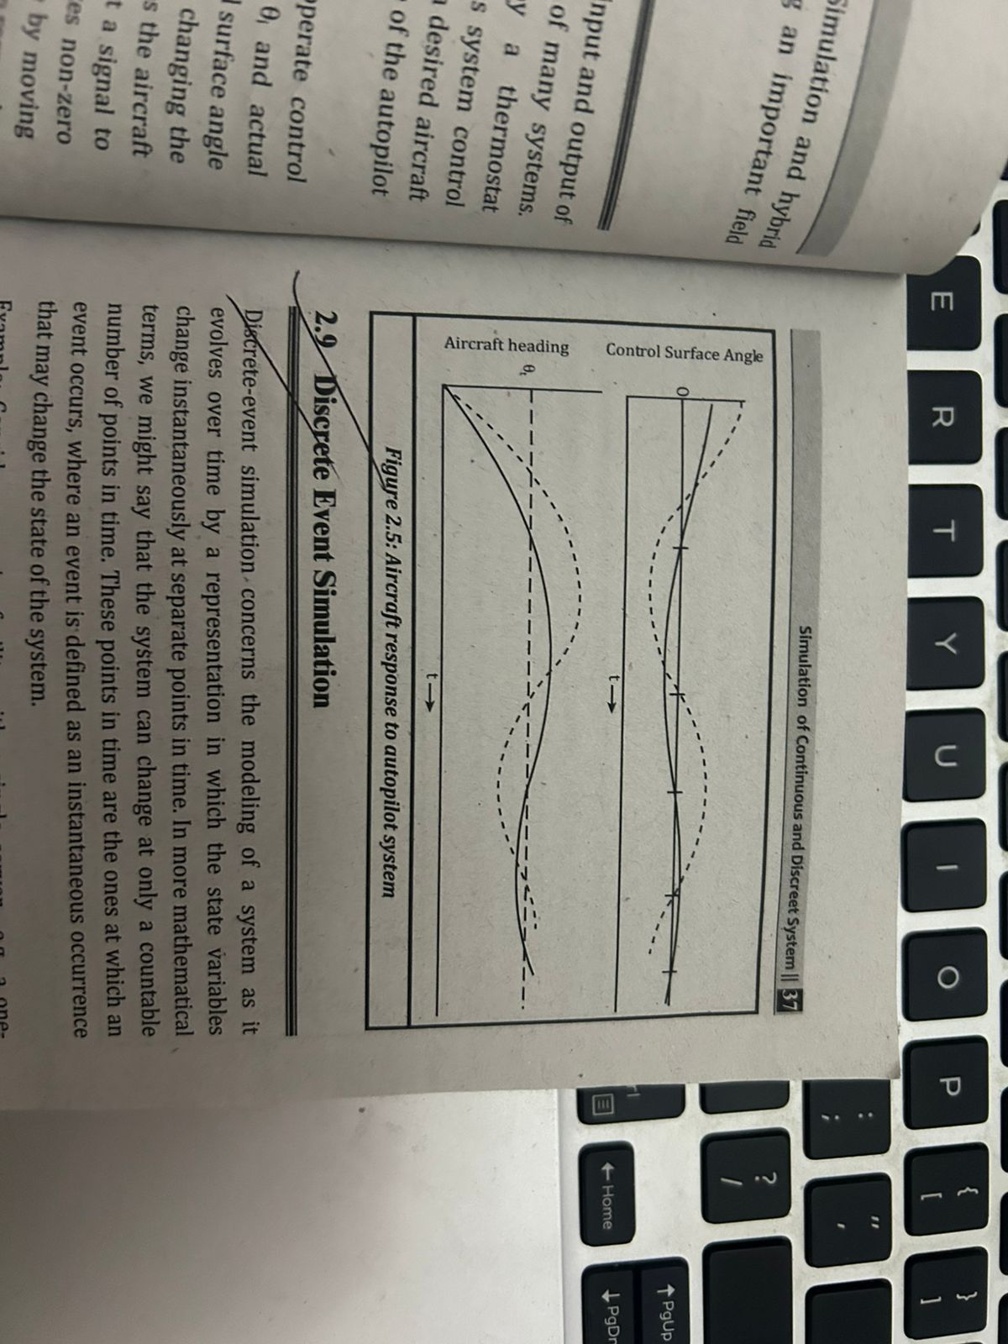

Slide 9
Basic Concepts of Simulation Tools
A simulation tool is a software application that models real-world systems to analyze their behavior under different conditions. It allows users to test scenarios, optimize performance, and predict outcomes without real-world risks or costs.
Simulation tools are widely used in engineering, manufacturing, business, healthcare, and computer science to model systems, evaluate different strategies, and make informed decisions.

Slide 10
Components of a Simulation Tool
Input Parameters
Defines the initial conditions of the system.
Examples:
In a factory simulation: number of machines, production speed.
In a hospital simulation: number of doctors, patient arrival rate
Mathematical Model
Represents system behavior using equations, rules, or logic.
Can be deterministic (fixed rules) or stochastic (random events).
Simulation Engine
Runs the model over time and records results.
May include visualization and data analysis tools.
Output Data
Provides insights through graphs, statistics, and reports.
Helps in decision-making and optimization.

Slide 11
Popular Simulation Tools
MATLAB/Simulink – Used for engineering, control systems, and signal processing.
Ansys – Finite element analysis (FEA) for mechanical and fluid dynamics simulations.
Arena – Discrete-event simulation for business and process optimization.
AnyLogic – Multi-method simulation for business, logistics, and healthcare.
NS-3 – Network simulation for wireless and wired communication research.

Slide 12
SUMO – Simulation of urban mobility for traffic and transportation planning.
Gazebo – Robotics simulation with physics-based modeling.
OMNeT++ – Network and distributed system simulation for academic research.
Crystal Ball – Monte Carlo simulation for financial forecasting and risk analysis.
COMSOL Multiphysics – Simulation of coupled physical phenomena in engineering and science.

Slide 13
Advantages of Simulation Tools
Cost-Effective – Avoids expensive real-world testing.
Risk-Free Testing – Evaluates dangerous scenarios safely.
Time-Saving – Runs multiple scenarios quickly.
Improves Decision-Making – Provides data-driven insights.
Enhances Optimization – Fine-tunes systems for peak performance.

Slide 14
Limitations of Simulation Tools
Requires Expertise – Needs knowledge to create accurate models.
Computationally Expensive – Complex simulations require high processing power.
Model Simplifications – May not capture all real-world complexities.

